Slide 1

Energy Harvesting Stop Button
By: Jonathan L. Lundaas Tor André Melheim Besart Olluri Simon Rømo Simen S. Røstad
In Collaboration with:
Nordic Semiconductor
& NTNU
Under the supervision of:
Audun Korneliussen
Torolv Skjølvsik
Rolf Kristian Snilsberg
https://github.com/simenrostad/Bachelor-Nordic_Semi
Notes:
Presentere oss selv. Takke samtlige
Spørsmål sist
Short presentation
Sjekk github

Slide 2
Disposition
Explain the assignment and project scope
A quick demonstration
The two supply solutions described in this thesis
Firmware description and flowchart
Results and conclusion

Slide 3
The Assignment
Energy harvesting
nRF52 transmitting BLE signal to set a "STOP" sign
Making a Showcase working prototype
Notes:
The assignment was to design and produce a replacement to todays wired stop buttons using an energy harvesting circuit and an nRF52 to send a
BLE signal to a central setting a stop sign to indicate that the bus is stopping. We have also made a showcase product to use here today for easy demonstration.

Slide 4
Project Scope
Make an energy harvesting circuit able to power the nRF52
Energy efficient code
Production and assembly
Notes:
When we first started this project we saw two main problems we needed to solve. first, we had to design and produce a small energy harvesting circuit able to power an nRF52, which was small enough to fit inside a classic bus stop button.
On the other hand we had to make a firmware energy efficient enough so that it was able to send the required signal for long enough for a central to pick it up only using the harvested energy.

Slide 5
Demonstration
Look at it go!
Notes:
My associates will now show off the button and how it works, X will power the central by means of a powerbank,
and the blinking LED indicates that it searches for a BLE signal. Now that Y presses the button from over there the stop sign will light up.
we will send the stop button around during the rest of the presentation for everyone to see!

Slide 6
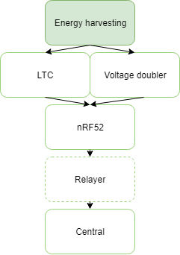
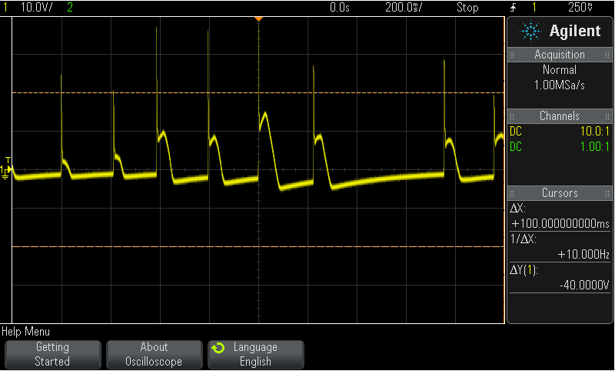
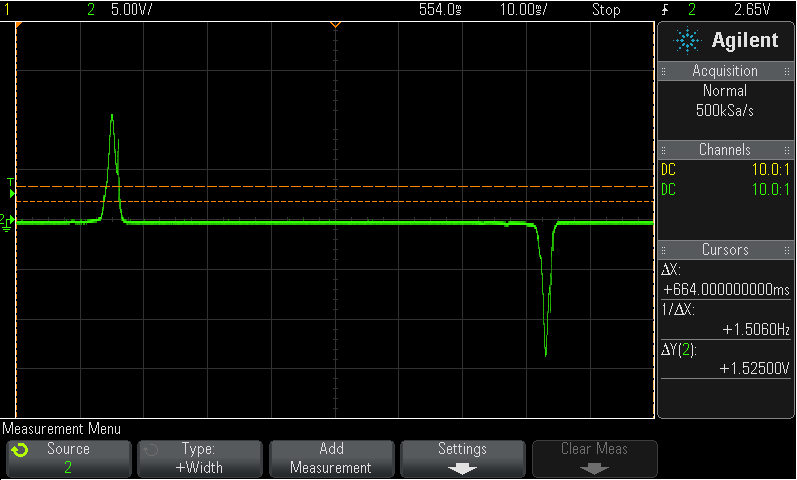
Inductive transducer vs. Piezoelectric element
Piezoelectric elements
AFIG-0007
Reliability
Piezo element AFIG-0007
Notes:
Generators - As the assignment proposed using piezoelectric elements, this was our initial thought.
But during one of our first meetings with the supervisors, they proposed looking into the AFIG-0007, an electromechanical generator by ZF electronics
Tests with the two generators proved the piezoelectric elements to be too fragile and have inconsistent results.
The AFIG however, had consistent test results and seemed durable, as well as already being a functioning mechanical button which would spare us time, and we ended up using this generator for the project.

Slide 7
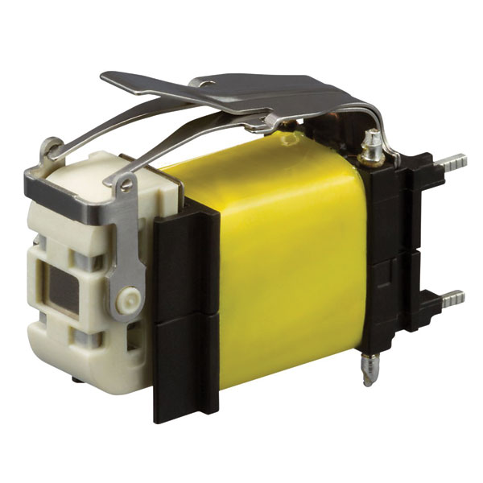
Producing the energy to power the nRF52
nRF52 energy consumption
61.7μWs for 8ms start-up
23.2μWs for 24ms per event
AFIG-0007 Energy production
The datasheet claimed 330μWs
Measured avrage to 270μWs
Meaning 9 BLE events if the system has zero loss(100% efficient).

Slide 8
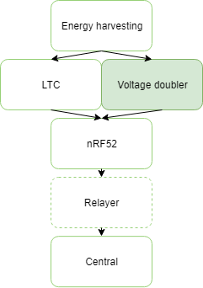
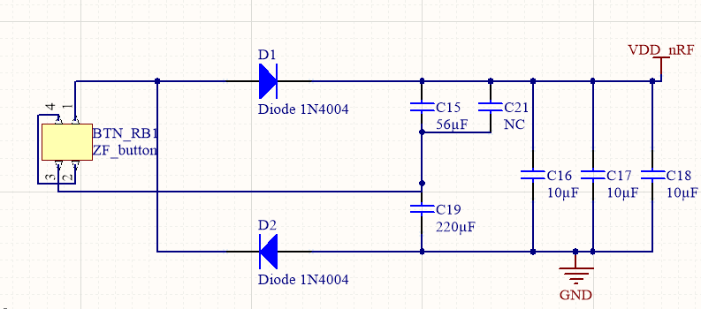
Voltage doubler
Rectification
Only two diodes
Efficiency
Usually with identical capacitors
Notes:
Utfordrende med å velge capacitor value

Slide 9
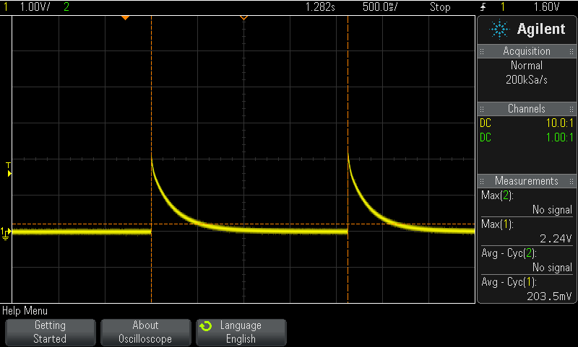
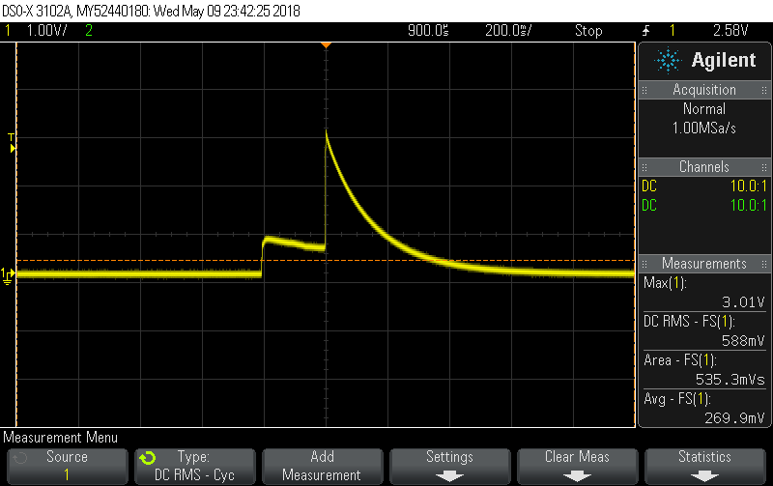
Voltage doubler – measured with 2.2kΩ load
2*47μF
μ
F
220μF and 47μF
a
Notes:
Focusing the energy on one point, Removing the need to run the startup twice.
A kind of DC ofset

Slide 10
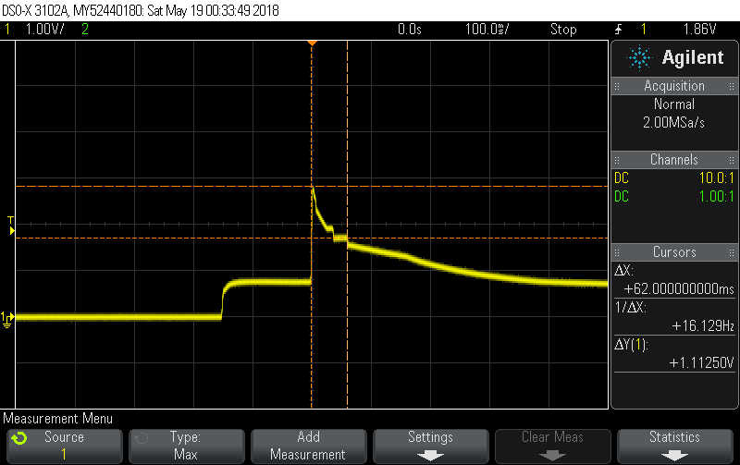
Voltage doubler
The nRF52 as load
220μF and 56μF as the main capacitors
2-3 events
Never surpasses the nRF52’s voltage treshold with a single push/relase.

Slide 11
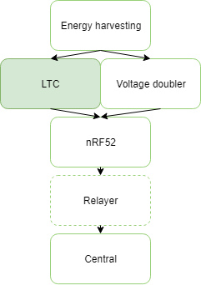
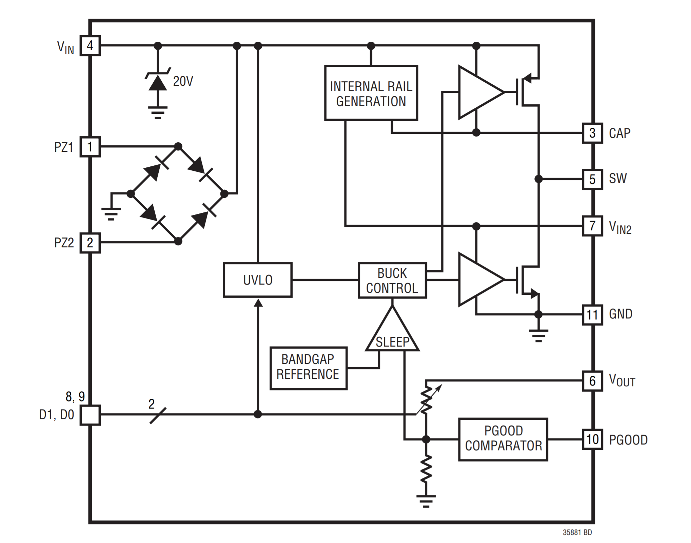
LTC3588-1
LTC3588-1 Operating voltage 3.77V to 20V
Output voltage configurations at 1.8, 2.5, 3.3 and 3.6V
Notes:
The second solution to powering the is by usingh a ragualtor IC
The LTC 3588-1 seemed like a good alternativ early on as it’s features and specification seamd ideal for ouer application. Its working Area where it successful transforms the energy to a given output voltage can be as good as from 3.77 volt to 20 volt as given by the data sheet. From testing we så valuese from approximately 4 volt to 19 volts. When det configuration output voltige was sett to 1.8 volts. If the output voltage was sett to a difrent configuration we så a the effective time window be reduced.
On the LTC-3588-1 we opted not to use the internal rectifier as it would result in a less efficient solution. As expleind in the previous slides a voltage doble was chosen as the rectifiacin solution. So the voltage dobler is used in both solutionens.

Slide 12
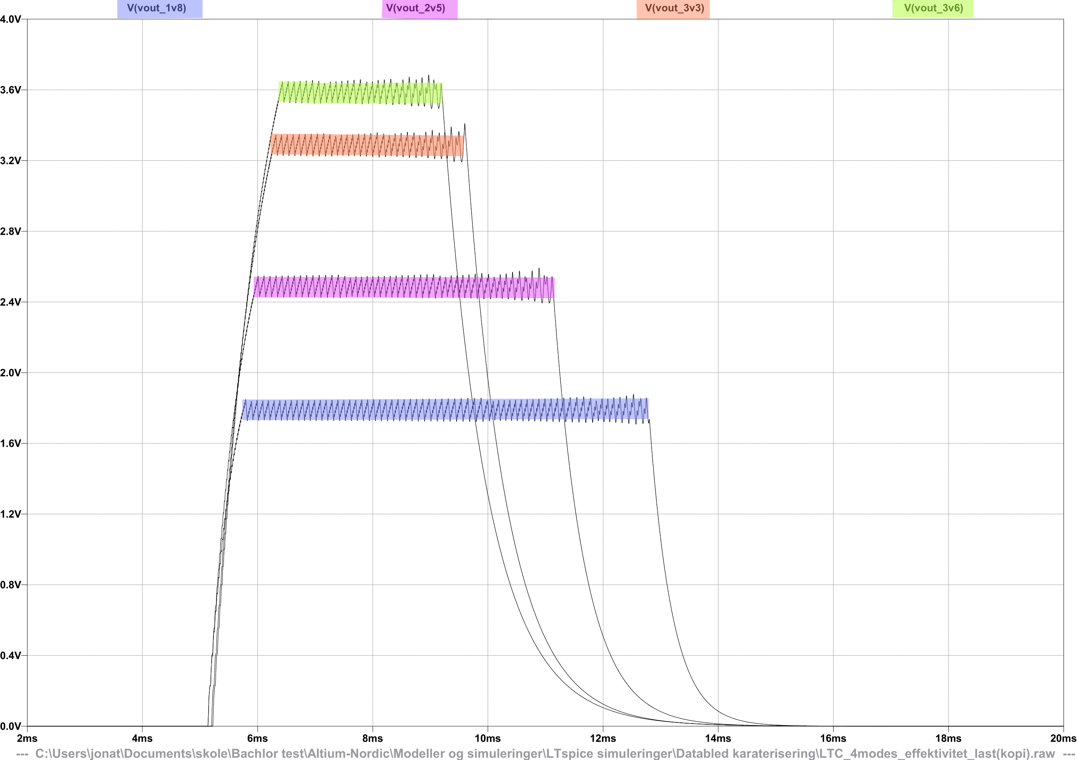
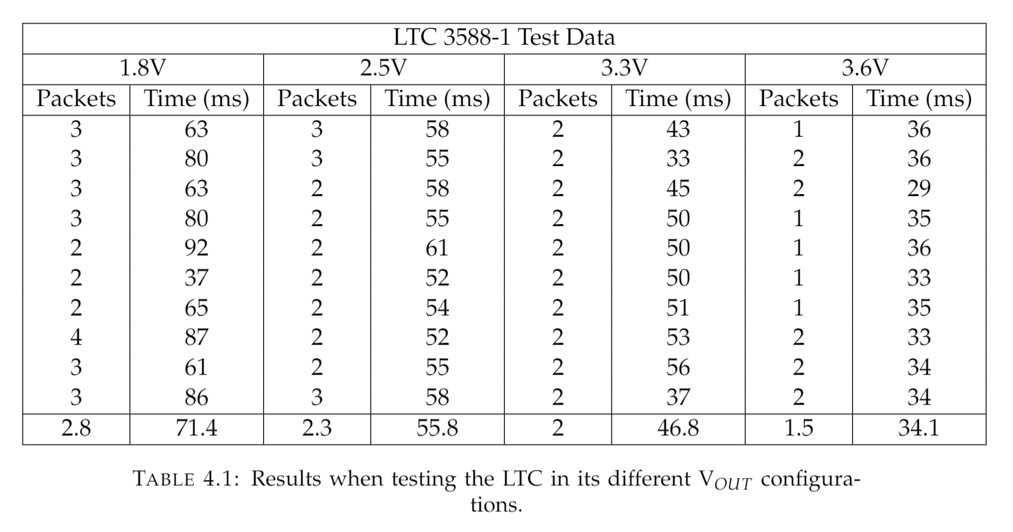
LTC3588-1
Simulation
Measurements
Notes:
Comparing the simulations to the mashurments we can se that the 1.8 volt configuration is wat gives the best results when providing the AFIG-0007 as the generator.

Slide 13
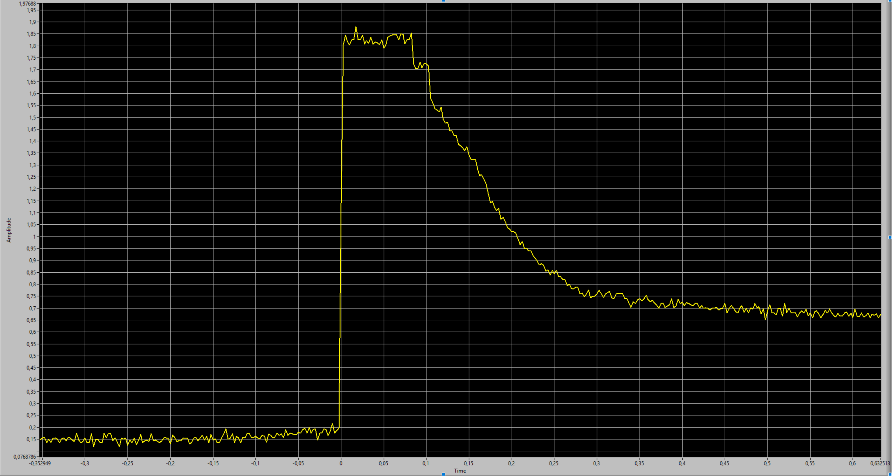
LTC3588-1
Output = 1.8 volts for 105 ms
Notes:
The output values of a 1.8 volt LTC configuration givin uss approx. 105ms of operating window

Slide 14
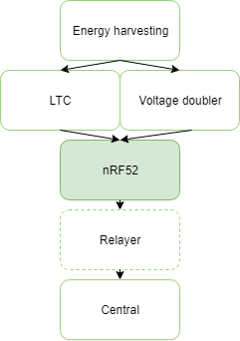
Stop Button Circuit
Generator: AFIG-0007
Rectifier: Full-wave voltage doubler
Optional regulator: LTC3588-1
SoC: nRF52832
Antenna: Johanson Technologies' 2.45 GHz 2450AT18A100
Notes:
Nevne her at vi gikk for flere løsinger

Slide 15
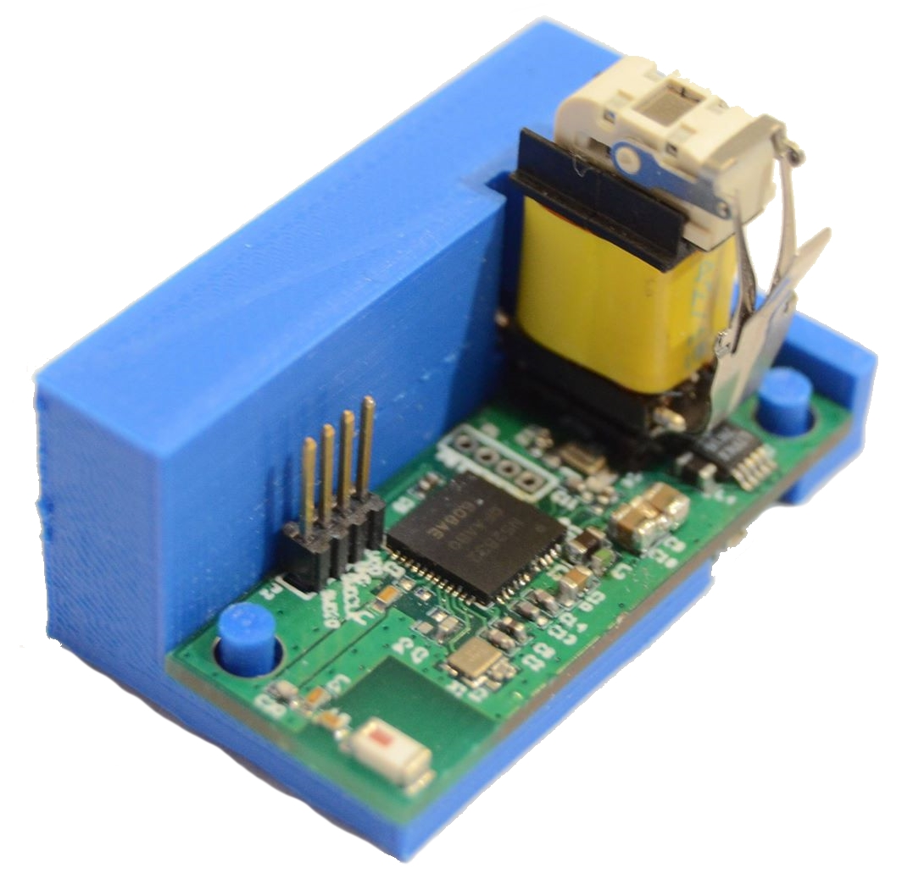
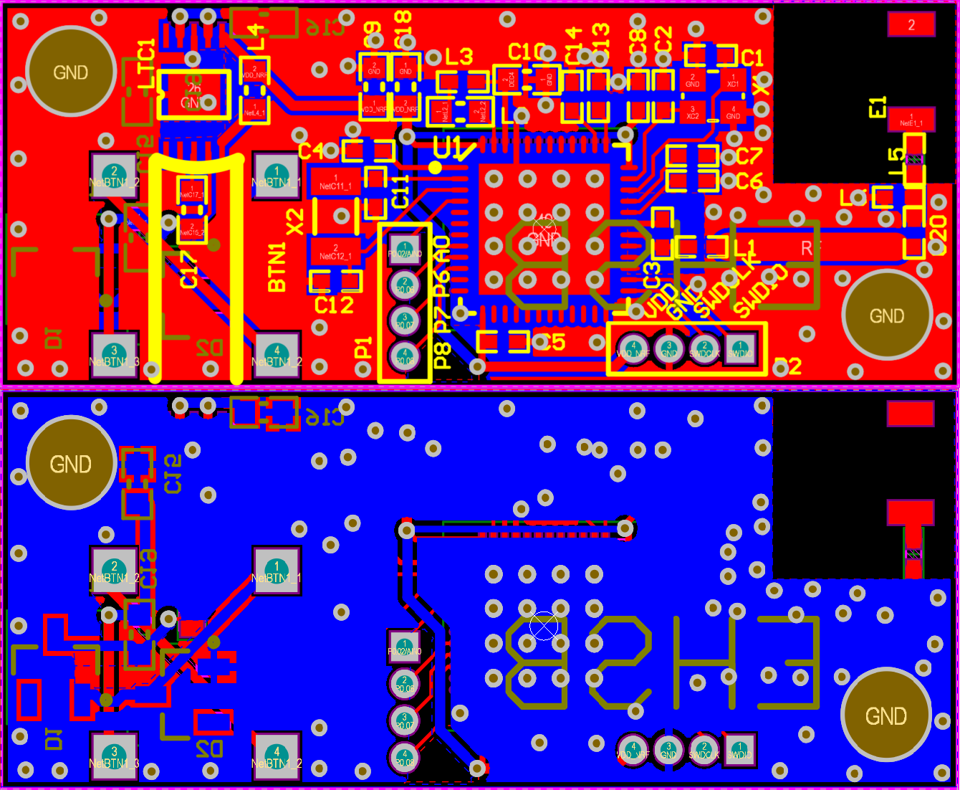
PCB Design
Altium for PCB design
Based on nRF52 reference design
34mm x 14mm
Notes:
PCB Design - For the PCB Design we have been using Altium Designer.
The PCB design you can see here is based on the nRF52s reference design, although it is somewhat altered to fit inside the stop button casing we showed here.
The final designs measurements are 34 times 14 mm. The figure presents the top layer, which is the red part, and the bottom layer of the design, the blue part.
The holes in the top left and bottom right corners are there to help the circuit board sit in place inside its 3D design, as you can see in this figure

Slide 16
Stop Button Firmware
Code efficiency, BLE stack, ID
TX payload = 21 bytes
TX power = 0dBm
Advertising interval = 20ms
LFRC
DC/DC regulator enabled
Notes:
Stop Button Firmware:
The stop button firmware was designed out of three main criterias. Number one was that the application firmware had to comply with the BLE specification, so bypassing the SoftDevice was not really an option. It was not desired to design some sort of propriety firmware.
Number two was that the code had to be so efficient that the nRF52 could be able to run for a reasonable amount of time with the available energy from the regulator circuit.
Number three was that the central needed some way of identifying the stop button in order for it to set the stop signal.
The firmware code is pretty straight forward. In the the main function two function are called. The first being initialization of the SoftDevice and the second being the initialization of the advertising data. In the advertising data the information advertised by the Stop button is set and build and advertising starts.
Off coarse, the device sleeps, in system on mode consuming approximately 1.9microWS between advertising events to save energy.
On the slide the most relevant stop button firmware settings are displayed.
The TX payload of the stop button contains an mandatory advertising flag BR/EDR not supported as well as a 128-bit UUID included for the central to identify different stop buttons. Using an 128-bit seemed like an logical options, because UUID collision between two 128-bit UUID is close to impossible, hence serving the purpose of redundancy. This way, two passing bus systems with different UUIDs would not trigger the respective stop signal.
The tx power setting is set as standard at 0DbM. The reason for this is that we did not have enough time to experiment with different tx power settings. It is possible that better results could have been obtained if this was the case.
The advertising interval is set at 20ms, the lowest possible in undirected advertisement. This is because the device should not sleep more than necessary to save energy.
The low frequency RF clock source is enabled because of its fast start-up time. Even though the energy consumption between the low frequency external oscillator and RC is very close, the RC clock is much faster.
Lastly the DC/DC regulator was enabled, simply because of its lower power consumption compared to the LDO regulator in this application area.
Results:

Slide 17
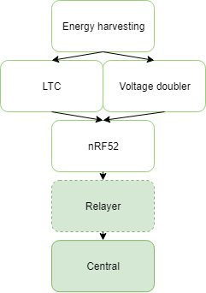
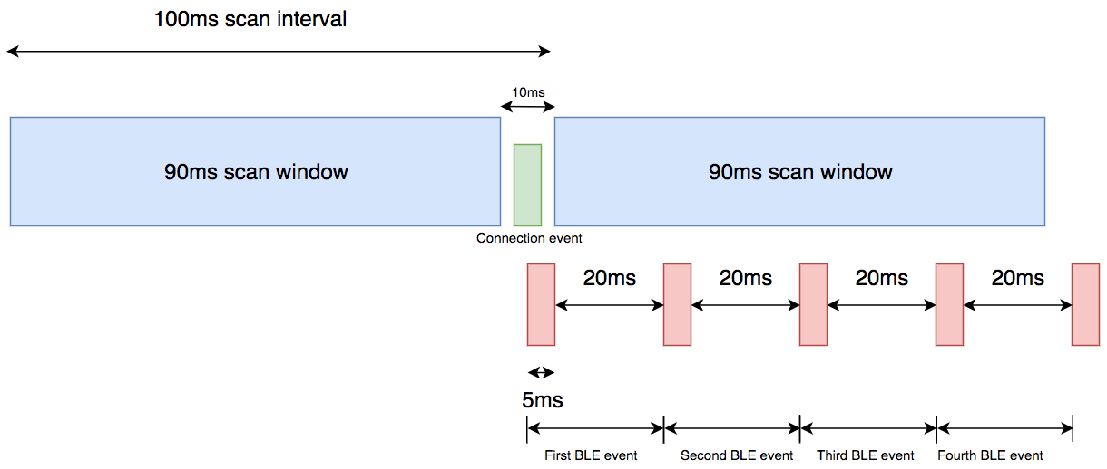
Central and Relayer Firmware
nRF52 development kit
Scans for 128-bit UUIDs
Relayer - Wireless UART (optional for longer range)
Central - UUID "whitelist"

Slide 18
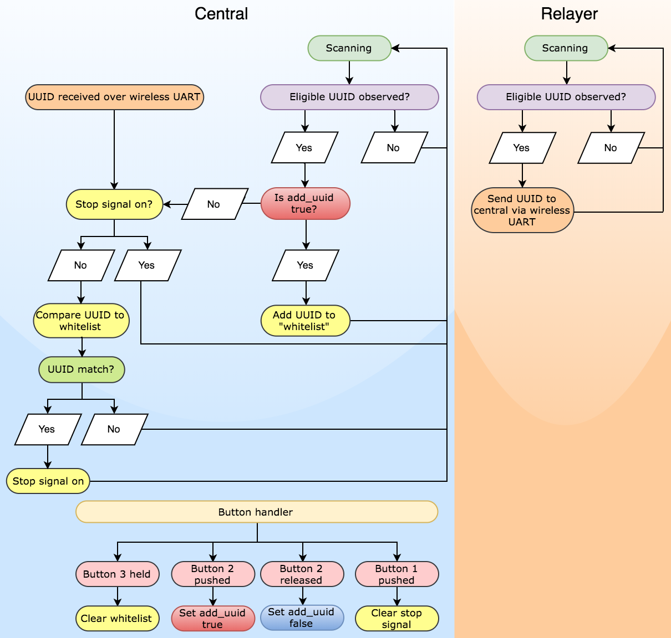
Application Flowchart

Slide 19
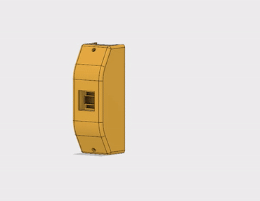
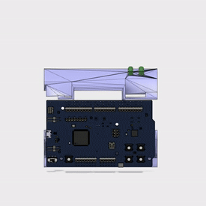
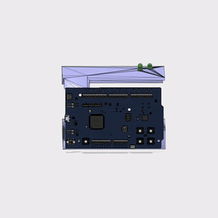
3D-print

Slide 20
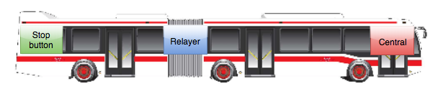
Results
LTC solution – 5 events
VD solution – 2 events
Field test, articulated bus approx. 19 meters
Relayer disconnected – 98% observation rate
Relayer connected – 99% observation rate

Slide 21
Conclusion
Proof of Concept solution with the range and observation rate to function in its intended environment.
Two working solutions
Possibilities for other applications (Remotes, switches etc.)
Notes:
Conclusion - This project concludes with a proof of concept solution, working as a bus stop button, having the range and observation rate required to work in its intended environment.
We've come up with two working solutions, both having pros and cons in terms of pricing, redundancy and expected lifetime.
We also believe there are possibilities for this concept working in other applications like simple remotes and switches.

Slide 22
Thanks for listening
Questions?​
https://github.com/simenrostad/Bachelor-Nordic_Semi

